Slide 1

Cps 109 Lab 5
Gurpreet Kaur
Mojan Nooshin Habibi

Slide 2
Agenda
Recursion
01
Mutability
02
Quiz
03

Slide 3
Recursion
Covered by Mojan

Slide 4
Mutability
You might have heard us saying that lists are “mutable”, and strings are “immutable”
Can you tell what does that mean?

Slide 5
Mutability
Something is mutable if its contents can be changed (like a list).
Something is immutable if its contents cannot be changed (like a string or a tuple)

Slide 6
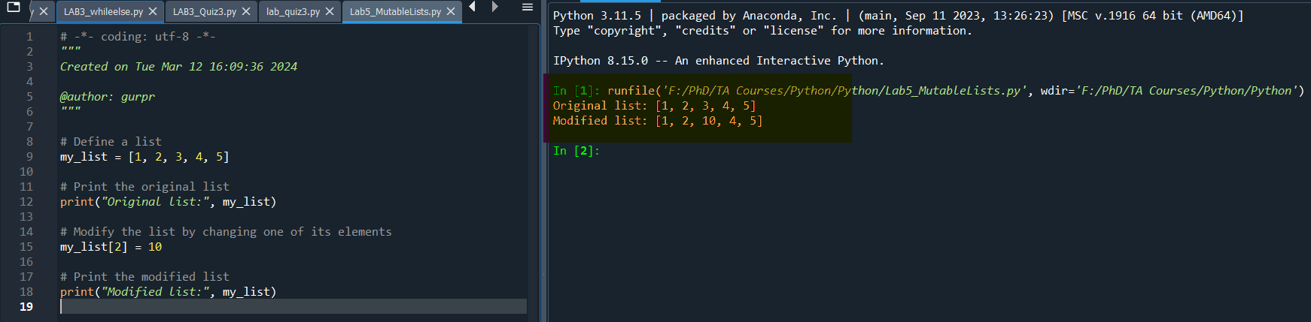
Example :: Lab5_MutableLists.py

Slide 7
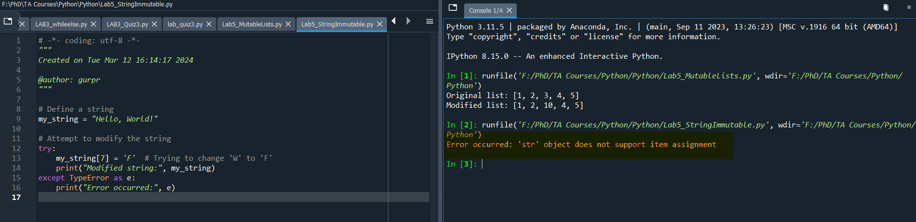
Example : Lab5_StringsImmutable.py

Slide 8
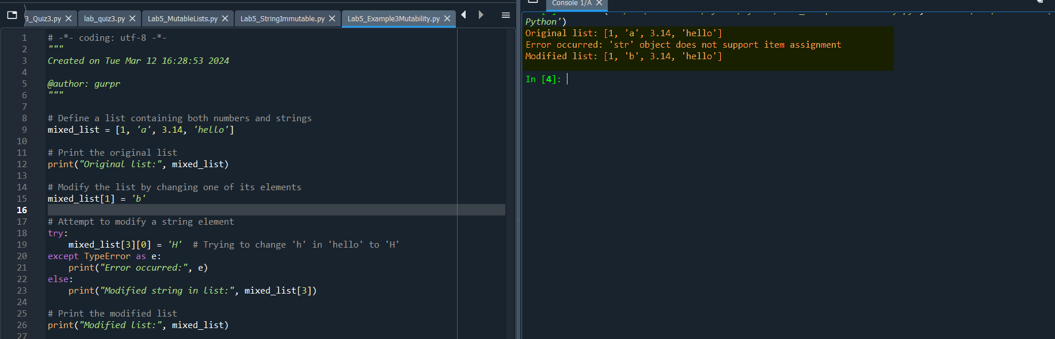
Combined Example : Example3Mutability.py

Slide 9
Thanks!!
Any Questions !!

Slide 10
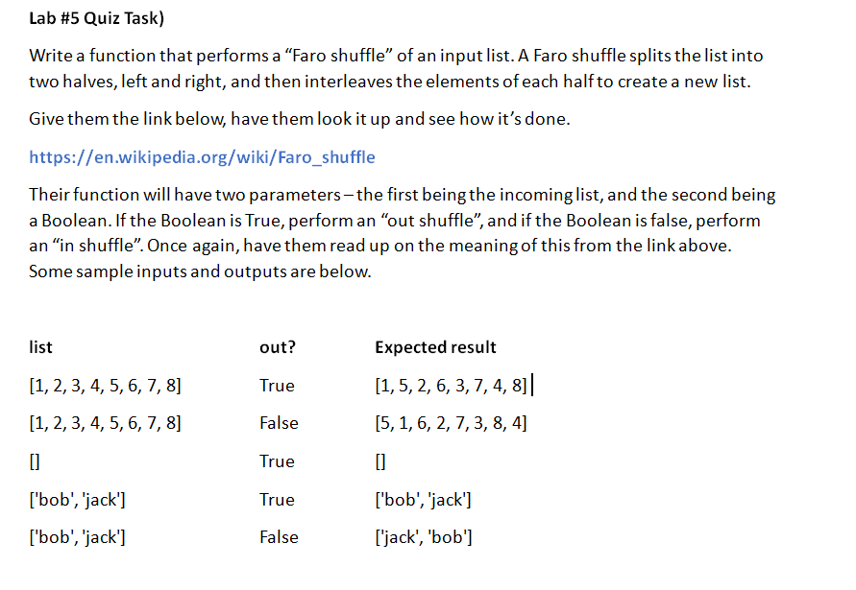
Quiz Time !!

